Slide 1

TGMS Y6 Open Evening
Agenda:
Key Stage 2 Standard Assessment Tests (SATs) (Mrs Bawany)
End-of-KS2 Writing Assessments
(Miss Baker)
PGL residential (Mrs Francis)
An overview of the Summer Term events and opportunities Y6 pupils participate in (Mrs Francis)
Notes:
SI

Slide 2
Key Stage 2 SATs
A Presentation to Parents
April 2025
Notes:
VP

Slide 3

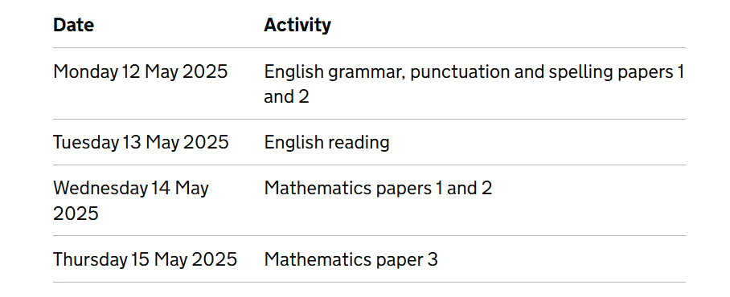
Key Dates SATS Week
Notes:
Uzma onwards

Slide 4
The Tests
Key Stage 2 SATs take place nationally in the week commencing 12th May 2025
Statutory tests will be administered in the following subjects:
Punctuation, Vocabulary and Grammar (45 minutes)
Spelling (approximately 15 minutes)
Reading (60 minutes)
Mathematics
- Paper 1: Arithmetic (30 minutes)
- Paper 2: Reasoning (40 minutes)
- Paper 3: Reasoning (40 minutes)
All SATS tests are sent off and externally marked.
Writing and Science are teacher assessed:
Writing will be teacher assessed internally as follows:
Working towards (D)
Working at expected level (S)
or working above (A)
Science will be teacher assessed as met, or not met the expected standard.

Slide 5
Grammar, Punctuation & Spelling
A spelling test is administered containing 20 words, which lasts approximately 15 minutes.
A separate test is given on grammar, punctuation and vocabulary.
This test lasts for 45 minutes and requires short answer questions including some multiple choice.
Marks for these two tests are added together to give a total for grammar, punctuation and spelling.
Notes:
HOC

Slide 6
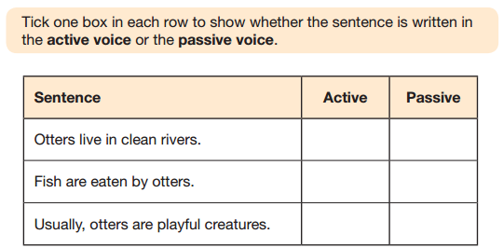
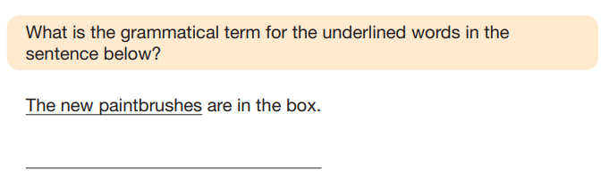
Sample Questions
Grammar, Punctuation and Spelling Paper 1
Notes:
HOC

Slide 7
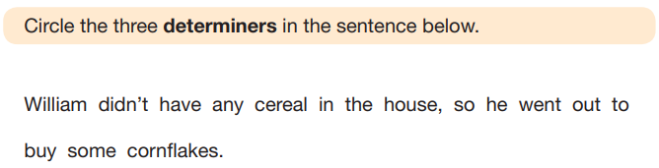
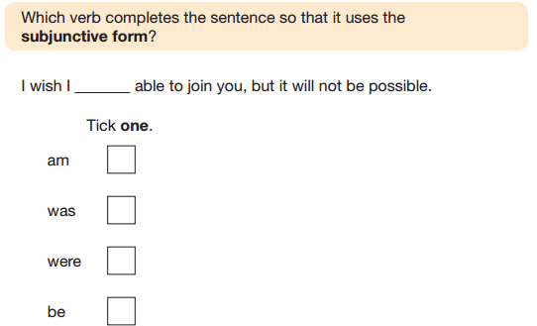
Sample Questions
Grammar, Punctuation and Spelling Paper 1
Notes:
HOC

Slide 8
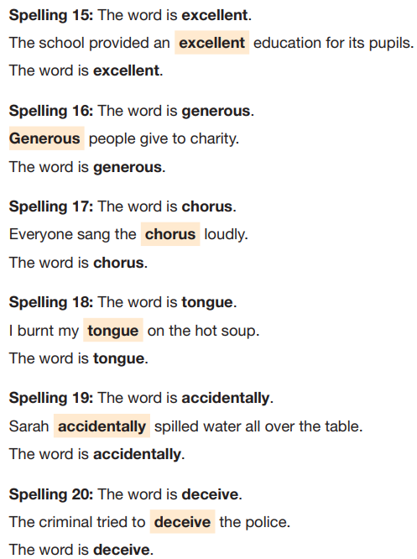

Sample Questions
Grammar, Punctuation and Spelling Paper 2
Notes:
HOC

Slide 9
Reading
The reading test consists of a single test paper with three unrelated reading texts. Children are given 60 minutes in total, which includes reading the texts and answering the questions.
A total of 50 marks are available.
Questions are designed to assess the comprehension and understanding of a child’s reading.
During the reading paper, a child’s inference and deduction skills are thoroughly tested. They will also be expected to answer questions on authorial choices: explaining why an author has chosen to use particular vocabulary, grammar and text features.
Some questions are multiple choice or selected response; others require short answers and some require an extended response or explanation.
Notes:
HOC

Slide 10
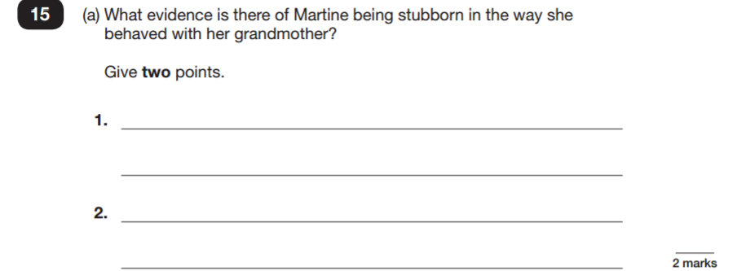
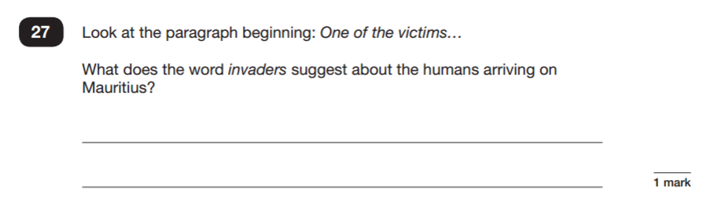
Sample Questions
Reading Paper
Notes:
HOC

Slide 11
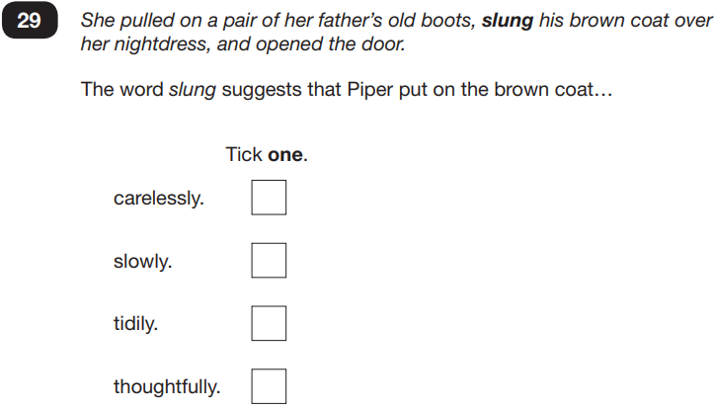
Sample Questions
Reading Paper
Notes:
HOC

Slide 12
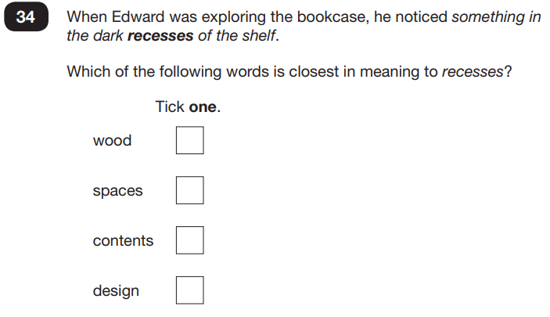
Sample Questions
Reading Paper
Notes:
HOC

Slide 13
Mathematics
Children will sit three tests: paper 1, paper 2 and paper 3.
Paper 1 is for arithmetic lasting for 30 minutes, covering calculation methods for all operations, including use of fractions, percentages and decimals.
Questions gradually increase in difficulty. Not all children will be expected to access some of the more difficult questions later in the paper.
Papers 2 and 3 cover problem solving and reasoning, each lasting for 40 minutes.
Pupils will still require calculation skills but will need to answer questions in context and decide what is required to find a solution.
Notes:
HOC

Slide 14
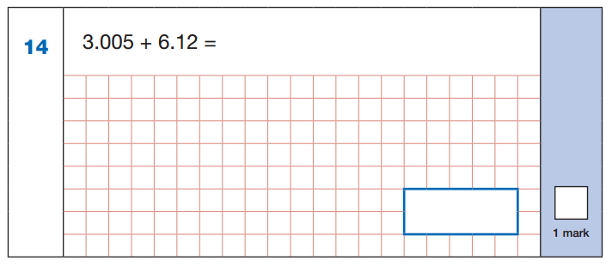
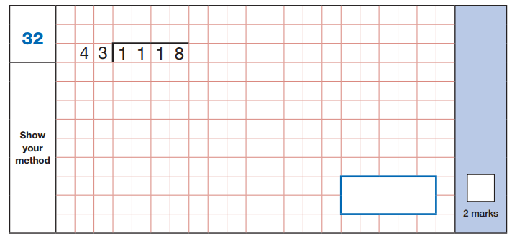
Sample Questions
Maths Paper 1: Arithmetic
Notes:
HOC

Slide 15
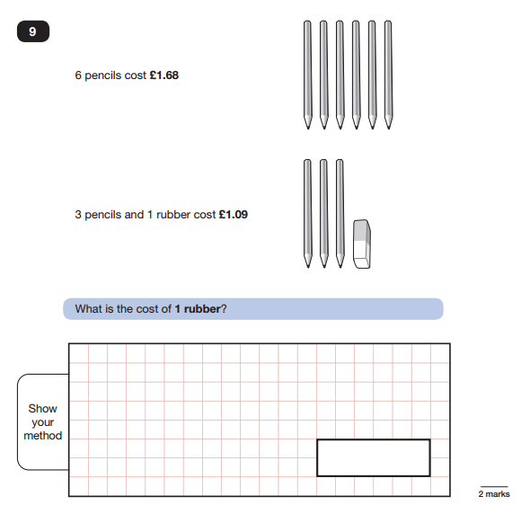
Sample Questions
Maths Paper 2 /
Paper 3 : Reasoning
Notes:
HOC

Slide 16
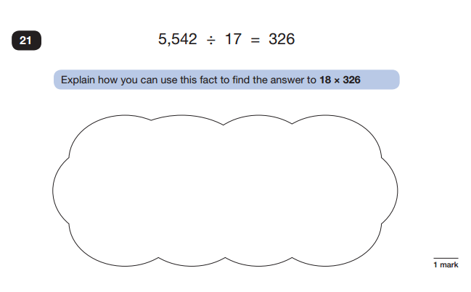
Sample Questions
Maths Paper 2 / Paper 3 : Reasoning
Notes:
HOC

Slide 17
What is expected at the end of Y6?
What ‘grades’ will my children receive?
Working at Greater Depth within A.R.E.
Age Related Expectations
Working towards A.R.E.
Working below A.R.E.
Notes:
Lesley onwards

Slide 18
What is expected at the end of Y6?
The children will be assessed in:
Maths (3 tests – arithmetic and reasoning [x2])
Expected mark is around 60% (out of 110); G.D. 85%
Grammar, punctuation and spelling (2 tests)
Expected mark is around 55% (out of 70); G.D. 80%
Reading comprehension (1 test)
Expected mark is around 55% (out of 50); G.D. 80%
Writing (Teacher Assessed)

Slide 19
How does the assessment system
used within school link
to predicted outcomes in SATS?
Above - predicted 110-120
Secure - predicted 100-109
Developing - Predicted 80 to 99 Scaled Score
Emerging - predicted significantly below national age related expectations, therefore pupil may not be entered for SATs
Notes:
VP

Slide 20
Assessment and Reporting - Scaled Scores
What is meant by ‘scaled scores’? Range of scores: 80 to 120
Attaining 100 will always represent the ‘national standard’.
Each pupil’s raw test score will therefore be converted into a score on the scale, either at, above or below 100.
Using the scaled score, the lowest a child can score is 80, with the highest being 120.
A child who achieves the ‘national standard’ (a score of 100) will be judged to have demonstrated sufficient knowledge in the areas assessed by the tests.
Each pupil receives:
a raw score (number of raw marks awarded);
a scaled score in each tested subject;
confirmation of whether or not they attained the national standard.
Notes:
VP

Slide 21
Pupils with specific needs
Pupils with specific needs may need additional arrangements so they can take part in the KS2 tests.
The school is able to consider support for pupils in accordance with guidelines issued by the Standards and Testing Agency - Access arrangements.
Access arrangements are primarily based on normal classroom practice, so we should already be aware of any specific needs.
Support can include the following: readers, prompters, testing in a different room, rest breaks and extra time.
Access arrangements should neither advantage nor disadvantage a pupil.

Slide 22

How to Help Your Child
First and foremost, support and reassure your child that there is nothing to worry about and they should always just try their best. Praise and encourage!
Ensure your child has the best possible attendance at school.
Support your child with any homework tasks.
Reading, spelling and arithmetic (e.g. times tables) are always good to practise.
Talk to your child about what they have learnt at school and what book(s) they are reading (the character, the plot, their opinion).
Make sure your child has a good sleep and healthy breakfast every morning!

Slide 23




Further sources of information and questions
TGMS website:
TGMS website:
Google Classroom: Lots of resources have been placed on there.
BBC Bitesize: https://www.bbc.co.uk/bitesize/articles/zrybvk7
Past SATs papers: https://www.satspapersguide.co.uk/ks2-year-6-sats/ks2-year-6-sats-papers/

Slide 24
Assessment of writing
Notes:
Lucy onward

Slide 25
How do we assess writing?
It is a continuous process with formal assessment taking place periodically throughout the year.
We assess using published pieces of independent writing which is completed following a sequence of teaching and editing.
We use our English pieces of work and sometimes from other areas of the curriculum e.g. history and science where extended writing has taken place. This is still independent.
We look to see where the children have demonstrated the key skills across a range of pieces.
Notes:
Lucy

Slide 26
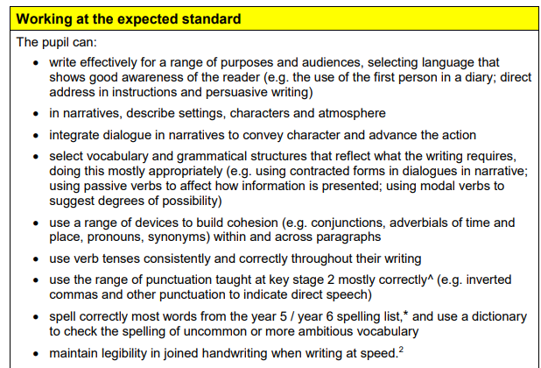
The assessment framework is a secure fit.
Broadly, children need to be able to write effectively for a range of purposes and audiences.
Select vocabulary and grammatical structures that reflect what the writing requires.
Notes:
Lucy

Slide 27
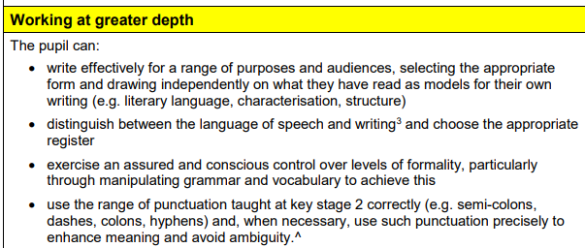
Greater depth writers push the boundaries using wider influences (e.g. reading and experiences).
…drawing independently on what they have read as models for their own writing.
…an assured and conscious control.
Notes:
Lucy

Slide 28
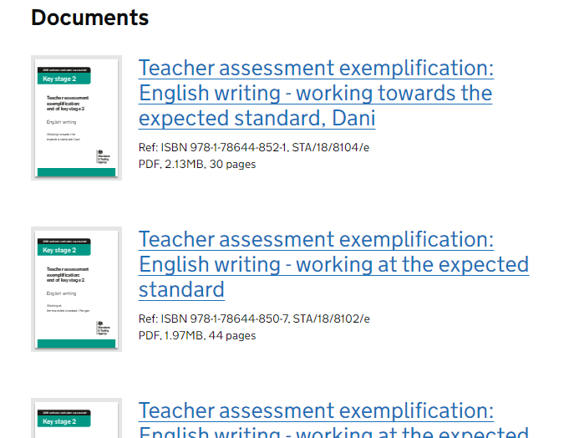
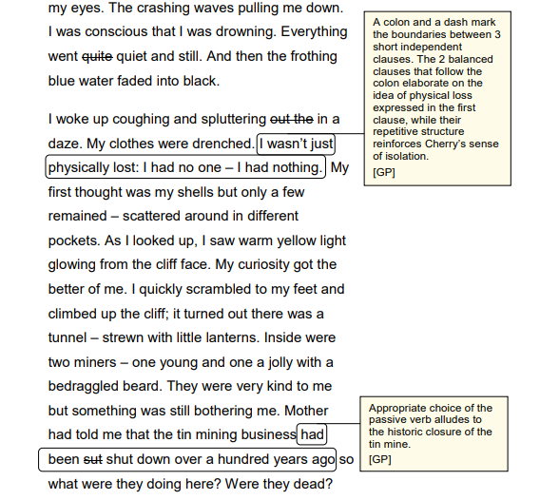
End of KS2 writing exemplification
Notes:
Lucy

Slide 29

YEAR 6 PGL TRIP
PGL Liddington
7-11th July
Notes:
Lesley onward

Slide 30
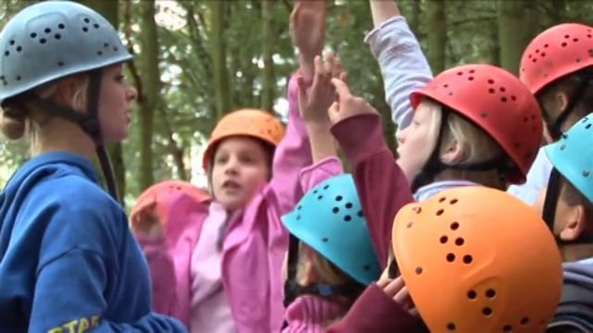
https://vimeo.com/74619774
Notes:
LF

Slide 31
Supporting the curriculum
The purpose of our residential visit can be divided into two main areas:
The Outdoor Adventurous Activities
(supporting the PE curriculum)
The Personal and Social Development of the children
(supporting the PSHE curriculum) - developing self-esteem, peer support, confidence and positive attitudes which attribute to raising motivation and achievement in other areas
Notes:
LF

Slide 32

PGL Liddington
Notes:
LF Our school has visited this site for the last three years.
PGL have been providing adventure holidays to children since 1957.
Both year groups thoroughly enjoyed the experience.

Slide 33
PGL Liddington
One of PGL’s biggest and best centres
Located minutes from M4 near Swindon
One hour coach journey
Former 4 star hotel and conference centre standing in 150 acres of grounds including woodland and 3 lakes.
Vast choice of activities
Outstanding facilities (meeting rooms, football pitches, floodlit all-weather sports pitch and netball courts)
Excellent standard of accommodation
Notes:
LF

Slide 34
Sample Itinerary
07.30 – Teachers wake the children
08.15 - Breakfast (English or Continental, cereal, toast and drinks)
09.00- First activity session
10.30 - Break
10.45 - Second activity session
12.15 - Hot lunch
13.45 - Third activity session
15.15 - Break
15.30 - Fourth activity session
17.00 - Supervised free time
17.30 - 19.00 – Two-course evening meal
19.00 - 20.30 - Evening entertainment. 21.00 - In rooms, ready to sleep (!)
Notes:
Lesley
Group Leaders assist Party Leaders until 21.00. From 21.00 - 23.00 there will be PGL staff on active night duty. Through the night there will always be a senior PGL staff member on call.

Slide 35
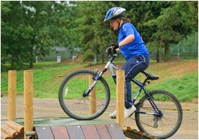
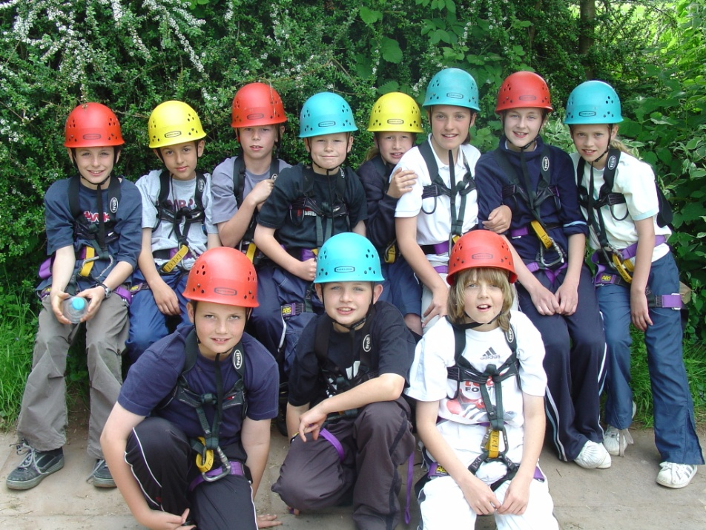
Kit List
Notes:
Lyn

Slide 36
Luggage – please name it!
Hand luggage, one bag per person
Essential items
OLD, CASUAL is essential
Night clothes
Several changes of underwear (including many pairs of socks)
Jumpers / fleeces / t shirts – long sleeved and short
Old trousers – tracksuit bottoms are best (minimum of 3)
Shorts (if warm weather) (knee length or longer)
At least 2 pairs of trainers.
Waterproof coat
One disco outfit
Drinks bottle
Sun tan lotion – important
Sun hat / cap
Sleeping bag and pillow
Wash bag
Two towels
Strong plastic bags (for dirty washing)
Items not allowed
Mobile phones
Hand held games
Tablet devices
Electrical hair appliances
Aerosols (they may set off smoke alarms!).
Notes:
Lyn
Sandals/crocs for water activity

Slide 37
Medical
PGL are informed of medical information prior to departure
If your child has regular medicine, we will need to take it with us.
You must provide us with enough medicine for the duration of the trip, it must be in date, named, and the requirements for taking it clearly identified. It must have a printed doctor’s label on it.
Most children can control their conditions; in addition, parents should produce clear written guidelines as to what action must be taken.
It is also useful if your child can recognise their own medicine, as the medicine box does get full.
All medicines are to be signed into the medical book on the morning of departure, preferably by a parent.
Notes:
Lyn
Spare travel sickness tablet for some of the activities.

Slide 38
Medicine ~2
Medicines include travel pills
If there are any medical or personal issues which require special attention please notify the class teachers before the departure day.
Children who need inhalers should keep one with them at all times.
Forms will be sent home next week for your permission to give Calpol/Nurofen to your child should they require them when we are on the trip. We will therefore take a supply away with us.
Forms to be returned by Friday 3rd May
Notes:
Lyn
hayfever

Slide 39
First Aid
Qualified First Aiders are always available at the centre.
First aid kits are taken to activities.
Nearest hospital: The Great Western Hospital in Swindon– 7-minute drive away.
Notes:
Lyn

Slide 40
Money
Children will have no opportunity to spend any money
They are to bring no money
They may bring a small tuck box
Notes:
Lesley

Slide 41

Safety
Safety is the priority
Instructors trained to high levels
Learning Outside the Classroom Quality indicator awarded
Staff available all of the time including school staff
Notes:
Lmellor
Learning outside the classroom helps young people to develop the ability to cope with and experience a wide variety of challenges. It requires them to make informed choices and to understand and take responsibility for the consequences. It leads to a positive ‘can-do’ attitude. Risk and challenge can be provided in all learning outside the classroom contexts – from activities within school grounds, to adventurous expeditions overseas. LOtC is statisitcally very safe.

Slide 42
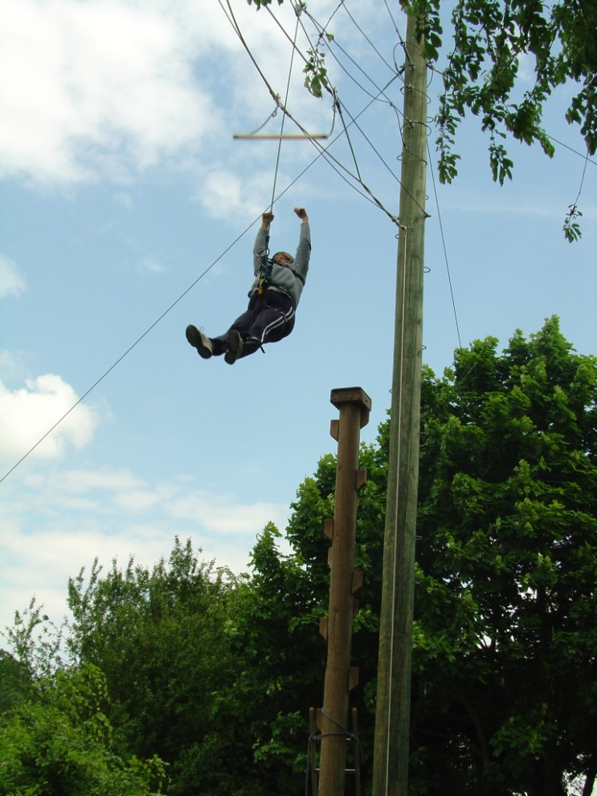
Safety
All safety equipment is provided by PGL
Children are told how to use the equipment before they start the activity and centre leaders check it is fastened, fits etc
The site is very safe and secure. There is always a member of PGL staff on call overnight
Notes:
Lyn

Slide 43
Communication
It is our school and the centre’s policy not to allow children to phone home during their time away – unless there are exceptional circumstances, agreed in advance
Staff will be in contact with the school everyday – keep an eye on the school website for updates
Children are not allowed to bring mobile phones
Notes:
LF – contact centre if there is an emergency outside of school time.

Slide 44
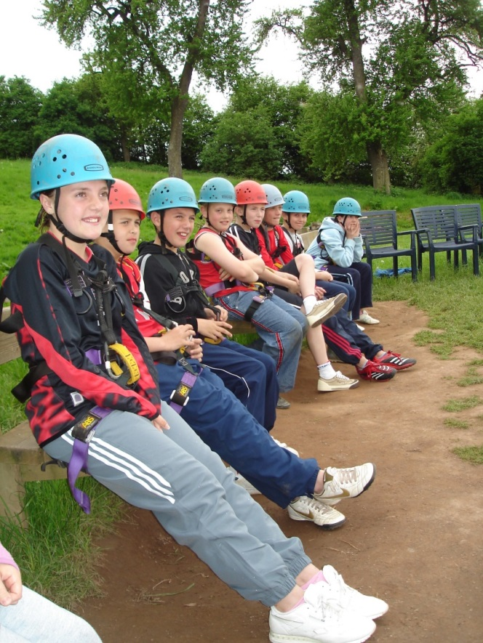
Groups
There will be two separate groupings:
Room groups (Children will be given their room groups on the day of departure but will have had the opportunity to select preferred companions; adults’ rooms positioned alongside children’s rooms)
Activity groups (there will be 5 or 6 of these)
Notes:
LF

Slide 45
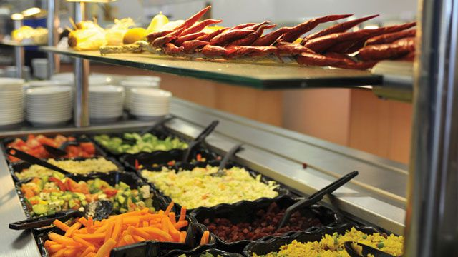
Food
All dietary requirements need to be identified before we go, otherwise they may not be catered for.
Sample menu could include:
Breakfast – choice of cereals and hot breakfast items
Lunch – jacket potatoes with choice of fillings and salad bar
Dinner – pasta bolognese/fish cake/cheese, onion and potato pie with new potatoes and peas followed by sponge pudding.
Notes:
LF

Slide 46
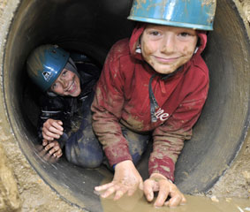
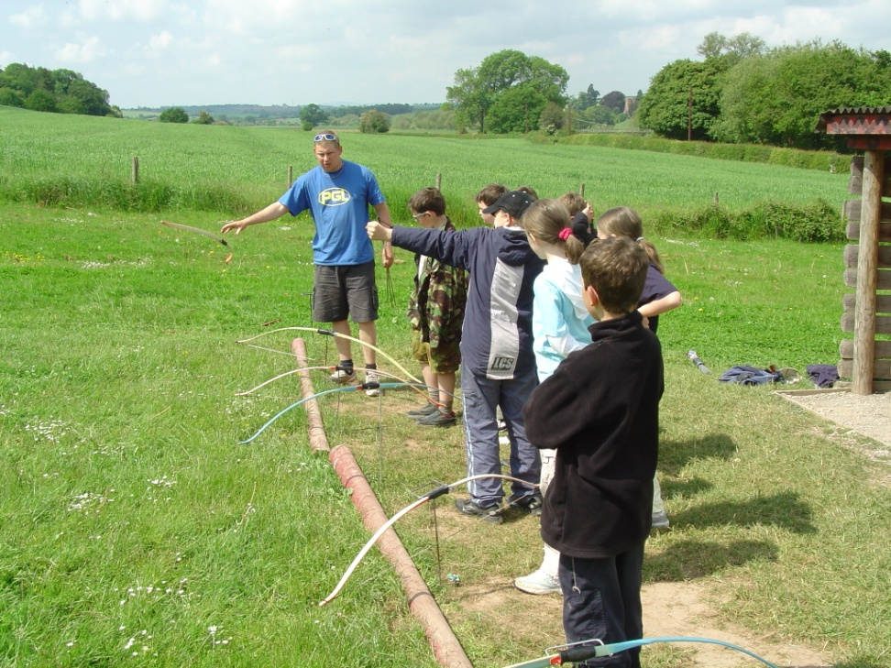
Archery and Tunnel Trail
Notes:
LM– can’t promise. We do provide a variety of activities – high/low/fast/slow/ problem solving/

Slide 47
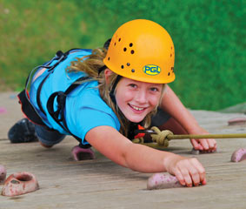
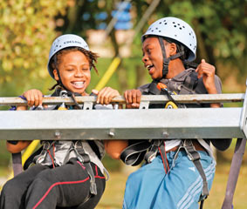
Climbing and Giant Swing
Notes:
LM Challenge by choice- they choose their challenge

Slide 48
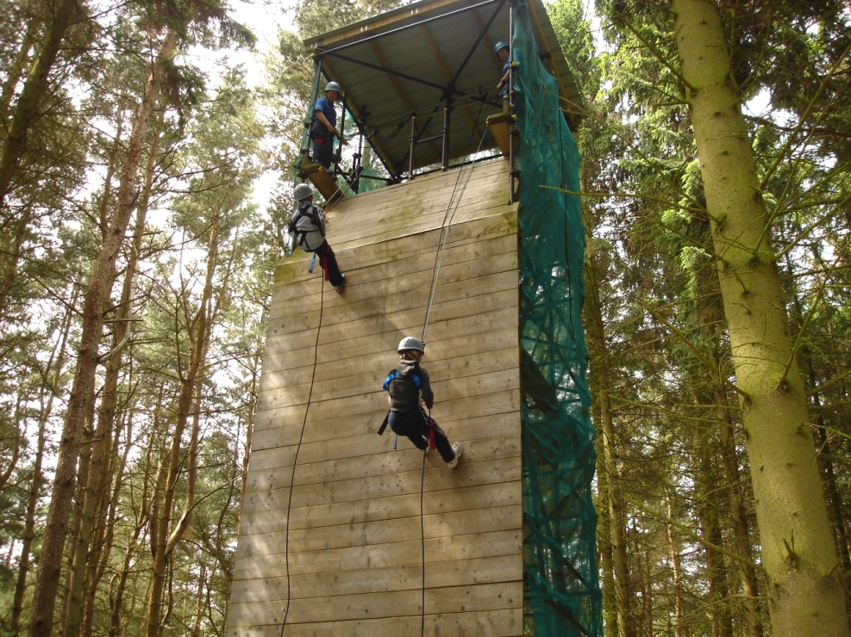
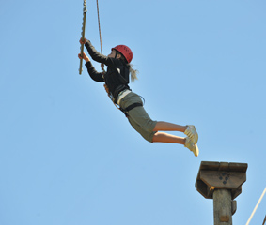
Abseiling & Trapeze
Notes:
LM

Slide 49
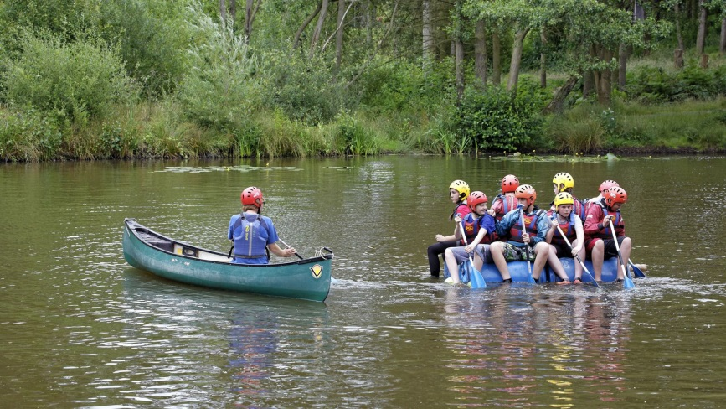
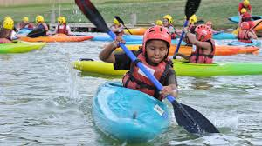
Kayaking and Raft Building
Notes:
LM

Slide 50
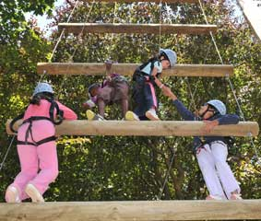
Our activities may include:
Abseiling
Climbing
Archery
Vertical Challenge
Orienteering
Giant Swing
Zip Wire
Kayaking
Raft Building
Aeroball
Notes:
LM

Slide 51
Strictly Year 6
SATs
PGL Residential Visit
Mini Enterprise
Sports Carousel Morning
Transition Workshops
House Captain Celebration Event
Leavers’ Performance
Notes:
LF

