Slide 1
Promoting positive behaviour and emotional wellbeing with your child at home
Tylers Green Middle School
21st May 2025
Dr Clare Otter, Educational Psychologist
c.otter@psychology4learning.com

Slide 2

Session overview
The concept of ‘parenting’
Shifting from behaviour management to understanding children’s emotional needs in line with their brain development
Parenting styles
Emotion Coaching
Hints and tips
Further information and support

Slide 3
What do we mean by ‘parenting’?
“Before I got married I had six theories about bringing up children; I now have six children and no theories.”

Slide 4


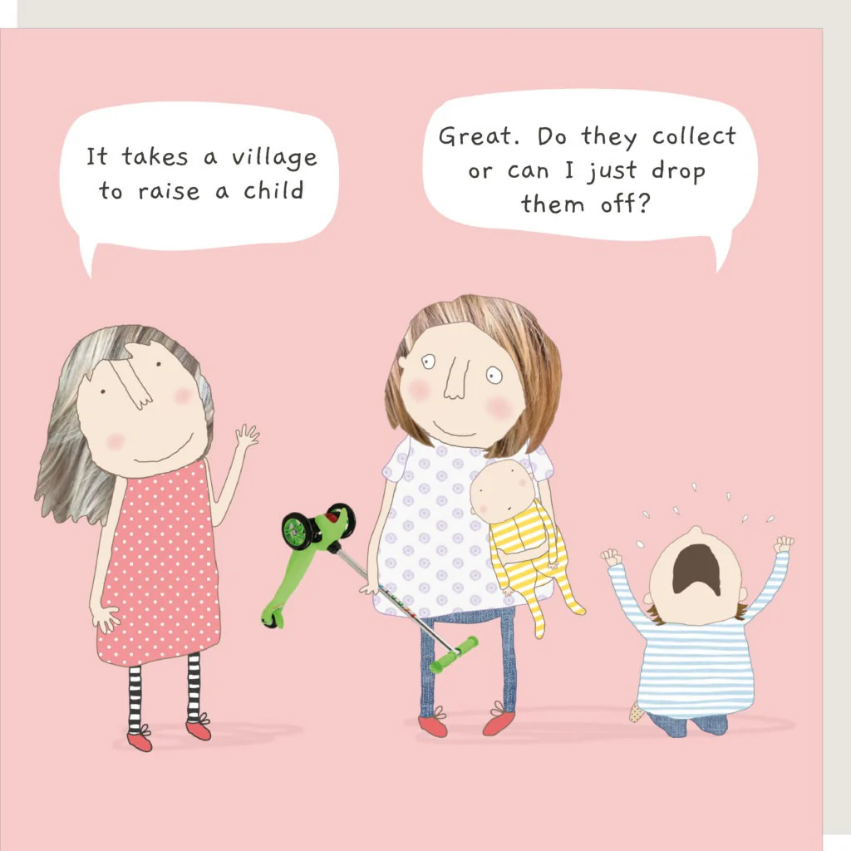
Influences on parenting

Slide 5
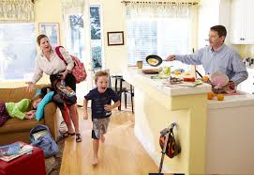

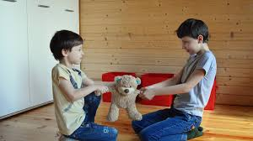


Parenting ‘pinch points’

Slide 6
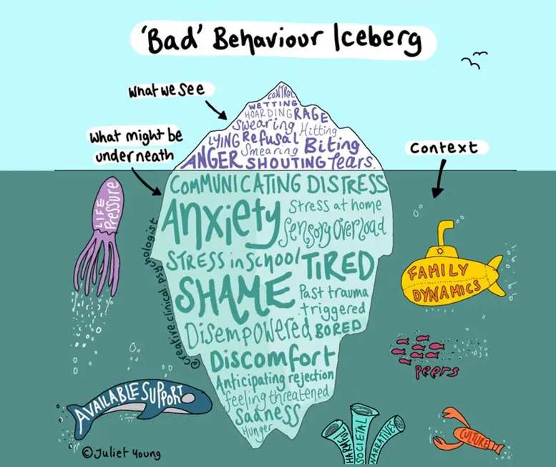
Shifting our focus from behaviour to unmet needs

Slide 7
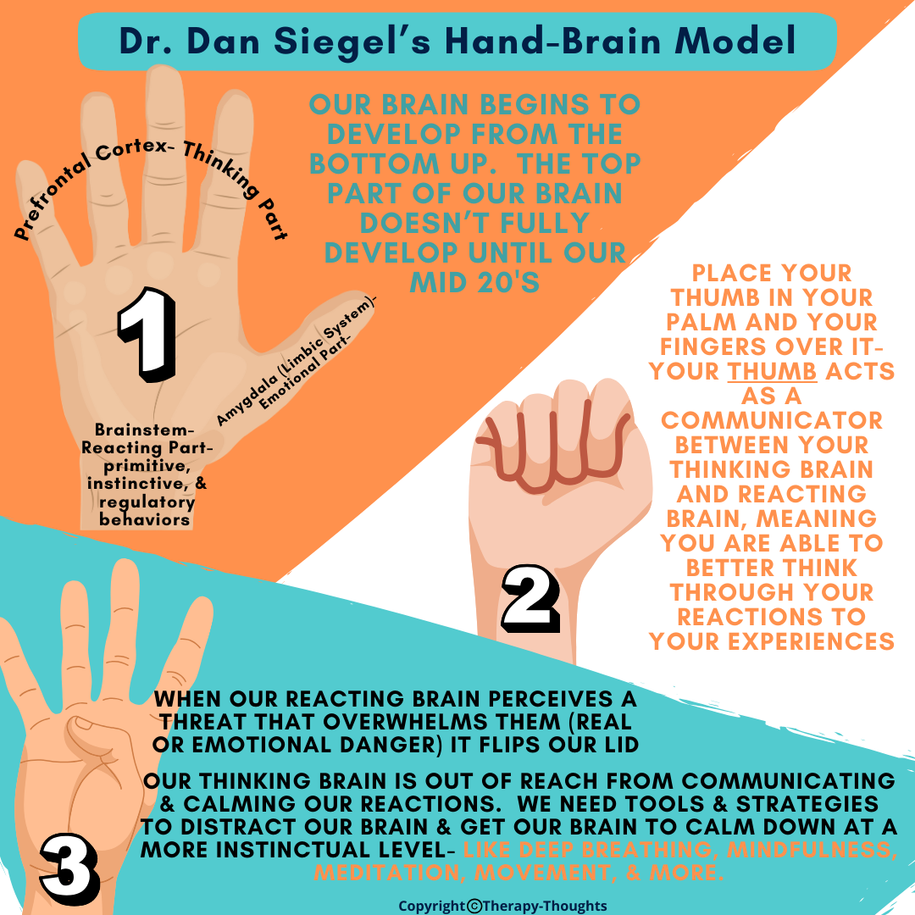
The Hand Model of the Brain
https://www.youtube.com/watch?v=Kx7PCzg0CGE&t=48s
The importance of adult co-regulation when children have ‘flipped their lid’ – you need to be their ‘upstairs brain’ in these moments

Slide 8
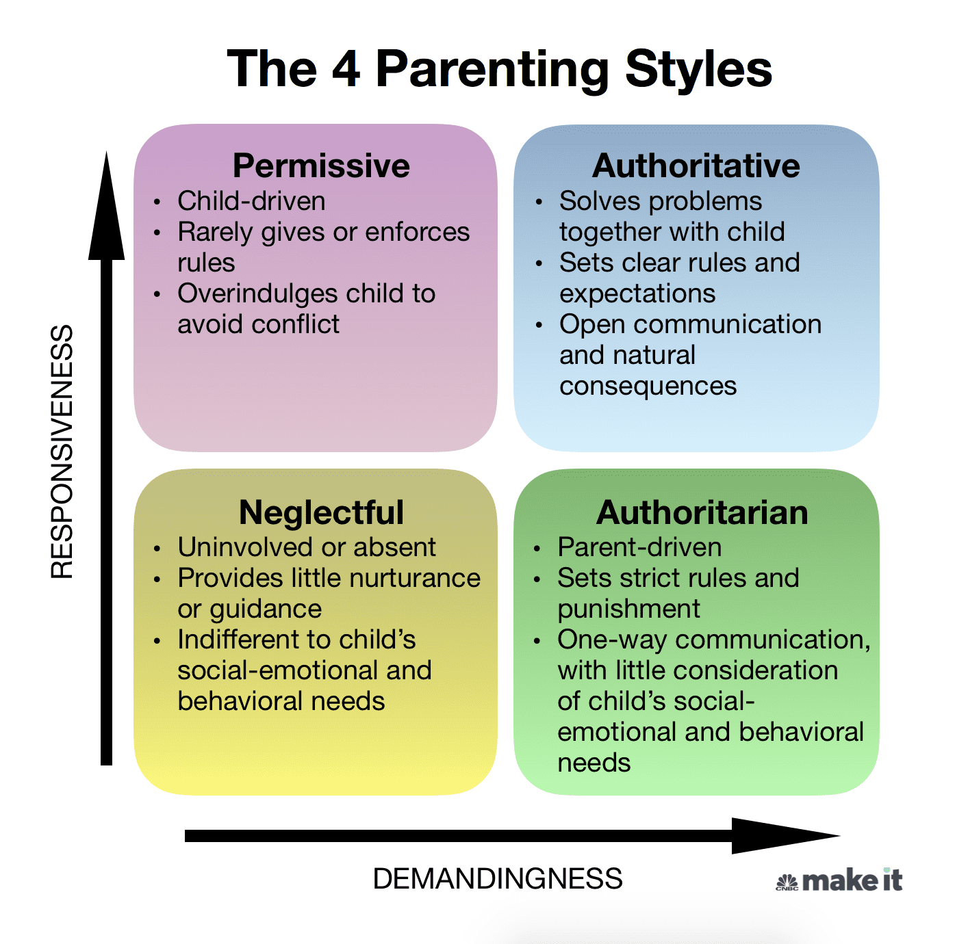
Four parenting styles
Permissive AKA Laissez Faire
Neglectful AKA Dismissive
Authoritarian AKA Disapproving
Authoritative AKA Emotion Coaching

Slide 9
Examples of the four parenting styles
Emotion Disapproving https://www.youtube.com/watch?v=yauGFcPAxIw
Emotion Dismissing https://www.youtube.com/watch?v=F8XuPU75Cg0
Laissez Faire
https://www.youtube.com/watch?v=wIWEZGr5dhE
Emotion Coaching https://www.youtube.com/watch?v=W7THt5xOESY&t=17s

Slide 10

Time to reflect
Which of the four styles do you tend to slip into most?
Where does this come from?
Which words do you use which are not your own?
What could you do more of?
Did you experience Emotion Coaching as a child?

Slide 11
Emotion Coaching
IS
ISN’T
Helping children understand:
the different emotions they experience,
why they occur and
how to handle them
Through co-regulation
A quick fix
Therapy
Dismissive or disapproving of emotional expression
Letting children behave however they want
A substitute for other interventions

Slide 12
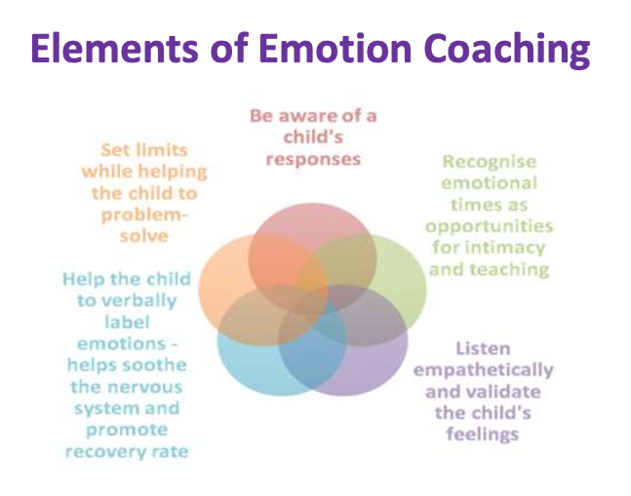
Emotion Coaching - overview
Overview video https://youtu.be/7KJa32r07xk
1 recognise the feelings (child’s and your own)
and empathise
2 validate and label the child’s feelings
3 set expectations for behaviour (if needed)
4 problem solving with the child

Slide 13
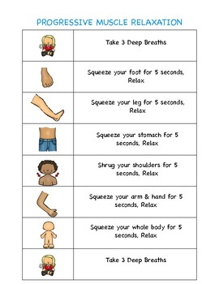
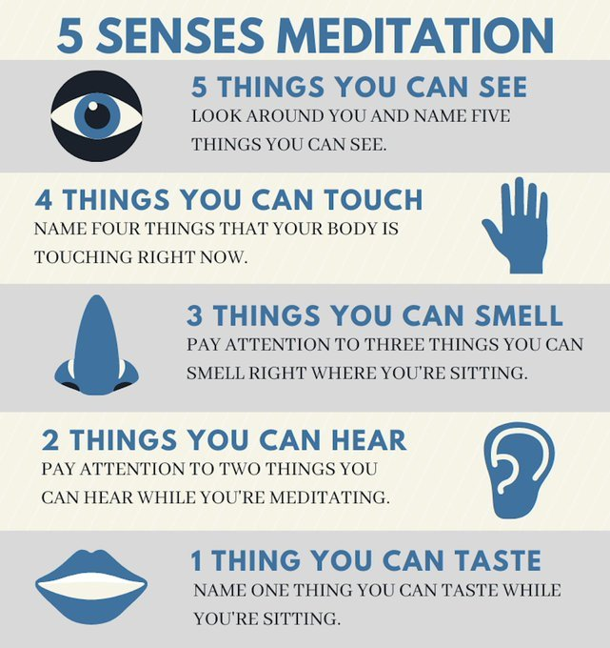
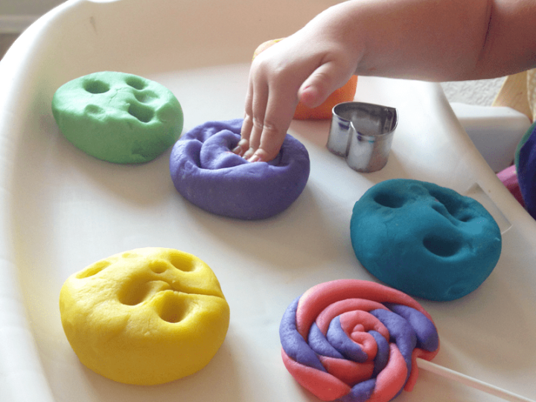

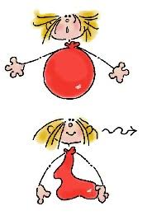


Before emotion coaching – child

Slide 14
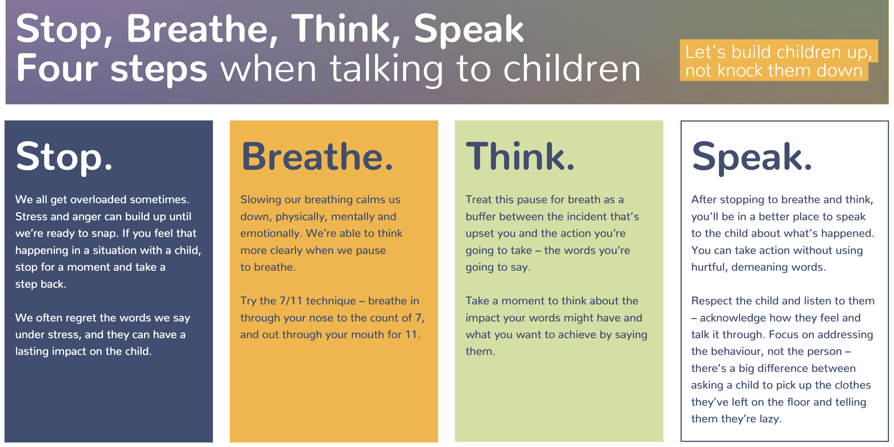
Before Emotion Coaching – adult

Slide 15
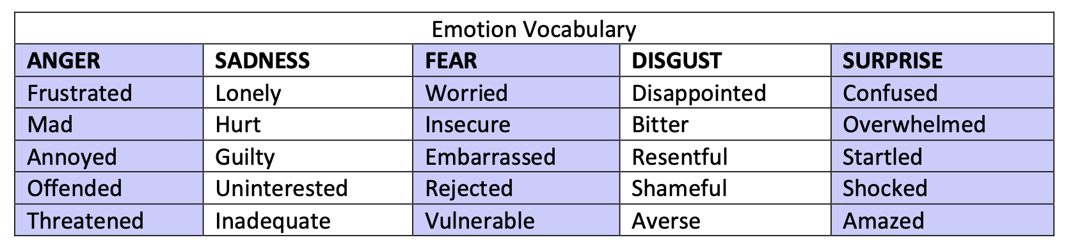
Emotion Coaching Step 1 – recognise and empathise
Be a feelings detective for your child
What emotions does this bring up in you?
Inside Out clip: empathy https://www.youtube.com/watch?v=t685WM5R6aM

Slide 16
Empathising with children
Motivated children need autonomy, competence and relatedness
A situation we put children in | A similar situation for adults | Emotions that may arise
Having a supply teacher
Being told to share a computer game with their sibling
Being told to eat something they don’t like
Being reprimanded for being late in front of the class

Slide 17

Emotion Coaching Step 1 – be a S.T.A.R.
Stop don’t react straight away, how is the behaviour making me feel?
Think what is going on for the child? What feelings are underneath the behaviour?
Attune put yourself in the child’s shoes
Reflect what would be an equivalent situation for you?

Slide 18
Emotion Coaching Step 2 – validate and label
I’ve noticed that…
I wonder if you’re feeling…
It seems that…
That sounds as if it was…
I’m sorry that happened to you
I would feel… if that were me
It’s OK to feel…
I get it
No wonder you were feeling…

Slide 19
Emotion Coaching Step 3 – set expectations
I understand you’re frustrated but it’s not OK to hit. Let’s find another way
It’s OK to feel sad. It’s not alright to hurt me
I realise it’s annoying when plans change but you have to stay where I can see you so I can keep you safe
I know you love this game but so does your brother and we need to find a fair way to share the controller
Remember we try to use words
Remember we use kind hands in this family

Slide 20
Emotion Coaching Step 4 – joint problem solving
Explore:
What did you want to happen? What do you think they wanted?
How did it make you feel? What does your body feel like now?
Share ideas:
Can you think of a different way to deal with it next time?
How about if you…? Let’s sort this out.
Agree solutions:
Let’s look at our list. Which one of these looks like it could help?
You could try X or Y, which one sounds like a good plan?

Slide 21
Scenarios
You receive a message saying that your child has been kicking a friend’s son and now they don’t want to come to school. You pick your moment and bring it up during a car journey but your child says they don’t want to talk about it.
You ask your child to stop gaming and to come and eat dinner. On the third reminder you unplug the console and shout that if they don’t stop being ungrateful their dinner is going in the bin.
Your child misses a penalty in a football match and runs over to you, bursting into tears. The referee is waiting for your daughter to return to the pitch before restarting the game and all eyes are on you.

Slide 22
Instead of:
You should be ashamed of yourself
Why are you always like this?
It’s not that bad
Because I said so
Don’t be a baby
Calm down!

Slide 23
Try:
I can see that you’re unhappy
You seem disappointed
This is really hard for you right now
I wonder what would be a better way to do things next time?
Can you help me to understand?
You really wanted to go to the party and now you’re cross that you can’t go
What can we do to fix this?
I can see your shoulders are tense and your face is frowning
Let’s take some deep breaths together and then make a plan
I’m here for you

Slide 24
The benefits of Emotion Coaching
Academic achievement
Delayed gratification and impulse control
Self soothing and resilience
Fewer infectious diseases
Socially included and popular
Adults feel more in control and have better adult-child relationships

Slide 25
Reminders:
Not every moment is an Emotion Coaching moment!
Connection before correction
The 4Ss: seen, safe, soothed, secure
Name it to tame it
More in control but less controlling
Be kind and compassionate not cruel and unkind
Know your own triggers and crumple buttons
You can’t pour from an empty cup
Repair is a valuable life lesson for your child – good enough parenting

Slide 26

A note on neurodivergence
Five practical tips:
https://wordsmatter.org/wp-content/uploads/2024/03/Words-Matter-Talking-to-neurodivergent-children-and-young-people.pdf
Collaborative and Proactive Solutions

Slide 27
Further information and support
Emotion Coaching UK
https://www.emotioncoachinguk.com/resources-for-professionals-parents-carers
Dr Becky Bailey coaching videos
Anger https://www.youtube.com/watch?v=xs7OWBj_GiE&t=24s
Happiness https://www.youtube.com/watch?v=J3_iGzQwQvk
Sadness https://www.youtube.com/watch?v=foOHvyv9CVI
Fear https://www.youtube.com/watch?v=U-Wtx-F7rXQ

Slide 28
Further information and support
Centre for Emotional Health
Step by step guides, tip sheets, print outs and templates
https://www.centreforemotionalhealth.org.uk/more-information/for-families/
Words Matter
Five Practical Tips for Communicating with Children
https://wordsmatter.org/wp-content/uploads/2023/03/how-adults-can-build-children-up-not-knock-them-down.pdf
What Not to Say
https://wordsmatter.org/wp-content/uploads/2025/02/words-matter-3-things-to-avoid-saying-to-a-child-when.and-what-to-say-instead.pdf

Slide 29

Further information and support
The Nurturing Programme
Free at the point of delivery
Aimed at parents of 3-11 year olds
3-5 weeks
Parents only, no children
Covers communication, understanding behaviour, emotional health
Suitable for children with additional needs – no diagnosis needed
https://familyinfo.buckinghamshire.gov.uk/advice-and-support/parenting/free-parenting-courses/

Slide 30
Further information and support
How to move up to secondary school:
Online session for Year 6s (via Teams, no need for
cameras and microphones to be on)
27th May 11-1 or 12th August 1-3
Covers what to expect, making friends, getting organised
Can lead to Supporting Your Child’s Transition to Secondary School course for parents and carers
https://familyinfo.buckinghamshire.gov.uk/youth/youth-courses-and-support/help-for-young-people/

