Slide 1
Subtraction SATs Questions

Slide 2
Question 1
Chen and Megan each buy a sandwich.
Chen gets 5p change from £2
Megan gets £2.25 change from £5
How much more does Megan pay than Chen?
2 marks

Slide 3
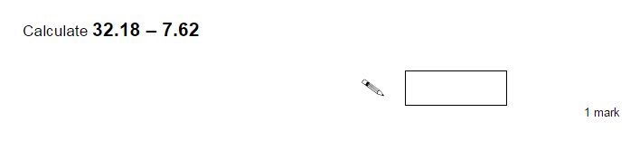
Question 2

Slide 4
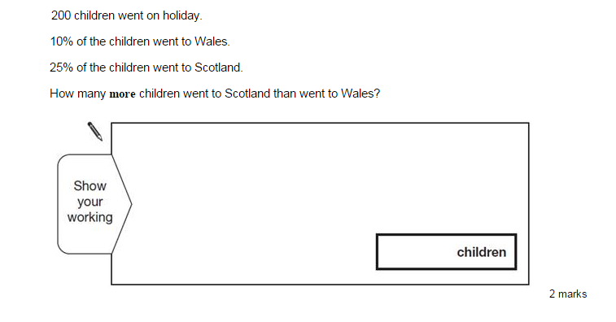
Question 3

Slide 5
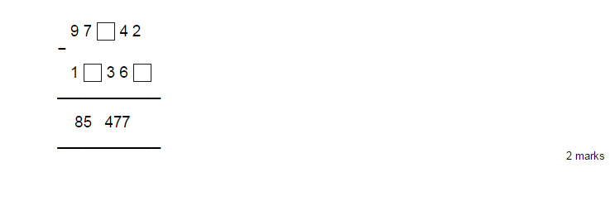
Question 4

Slide 6
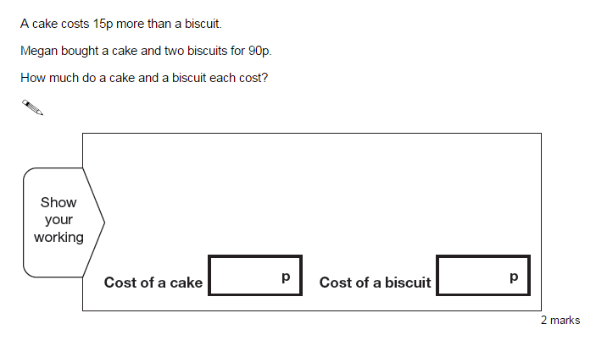
Question 5

Slide 7
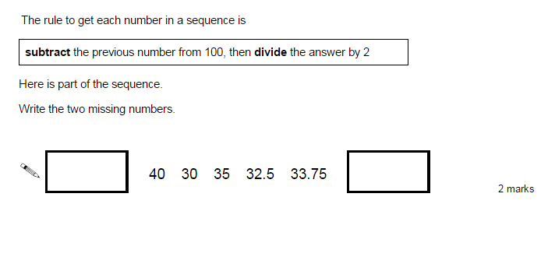
Question 6

Slide 8
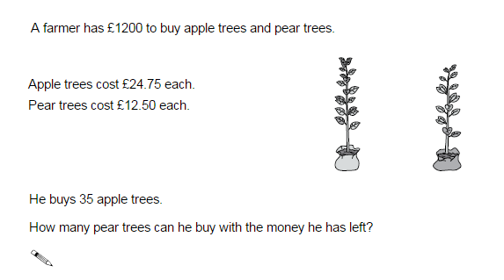
Question 7

