Slide 1
Multiplication SATs Questions

Slide 2
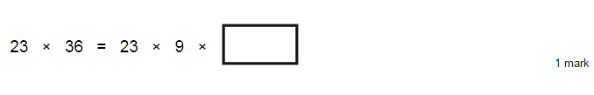
Question 1

Slide 3
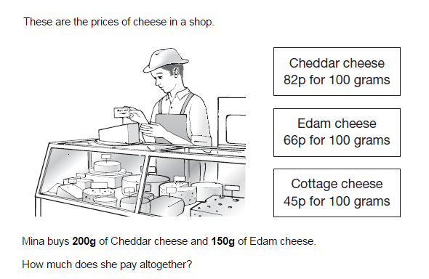
Question 2

Slide 4
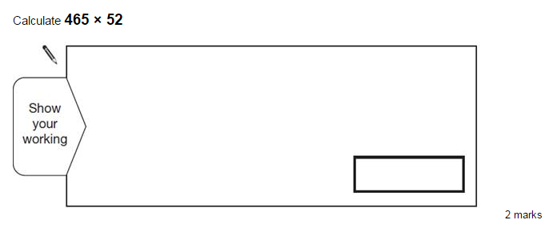
Question 3

Slide 5
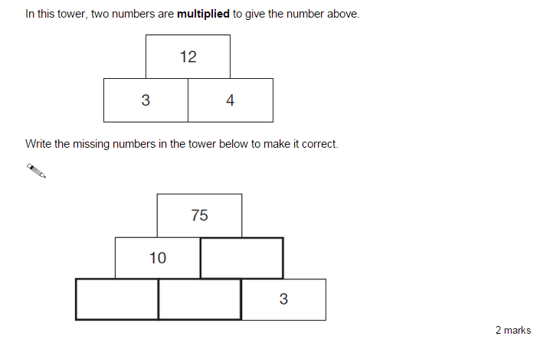
Question 4

Slide 6
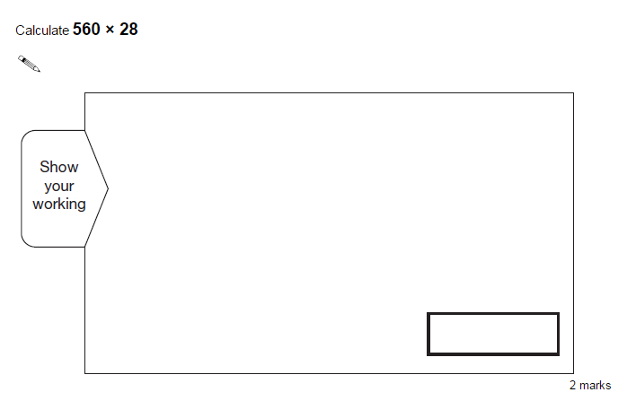
Question 5

